Slide 1

AI Marketing Agent for Smartwash Launch (MVP)
Problem
• Amazon Ads campaigns are manually managed
• Optimization is time-consuming and hard to scale
• Difficult to manage multiple campaigns, products, and keywords simultaneously
Goal
• Build an AI Marketing Agent to support campaign optimization
• Improve efficiency (ROAS ↑, ACoS ↓)
• Reduce manual workload

Slide 2

Modular AI Agent Architecture
Context & Policy Layer
Data Layer
Raw Amazon Ads data (campaigns, products, keywords)
Aggregation & KPI calculation
(CTR, CVR, CPC, ROAS, ACoS)
Entity building
(campaign / product / keyword)
Decision policy
(allowed actions & guardrails)
Decision Agent Layer
Execution Agent Layer
Execution (Future-ready)
AI agent analyzes
performance + objectives
Generates recommendations
Respects business rules and constraints
Validates recommendations
Converts them into action records
Logs all decisions for traceability
Ready for API-based automation (Amazon Ads API)
Currently:
Logging + Human review

Slide 3
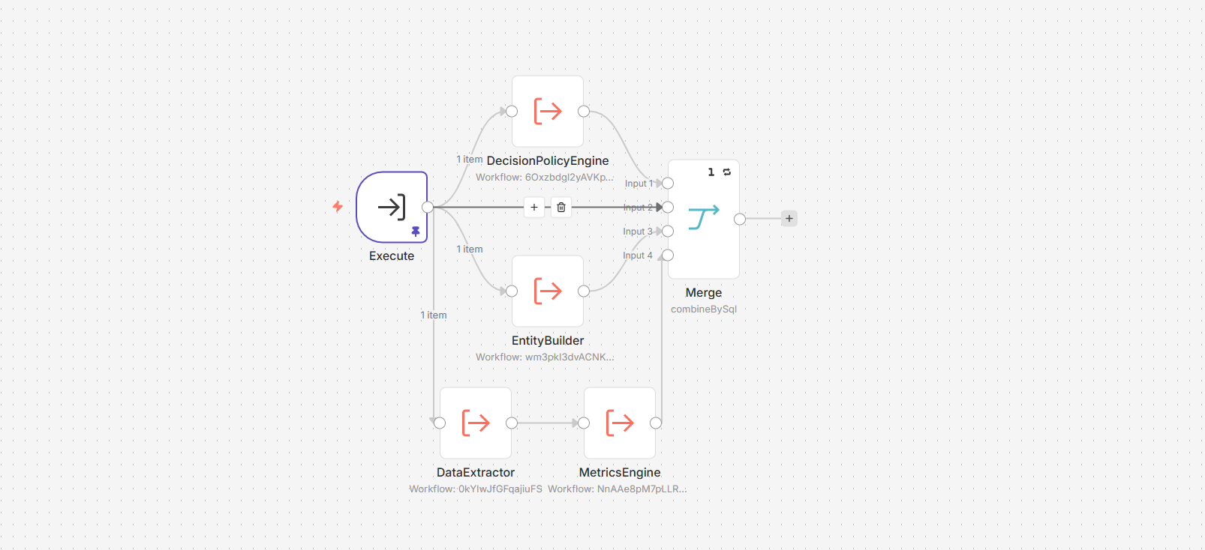
ContextAssembler
Transforms a simple request into a full decision context for the AI agent
Input:
Structured request (mode, filters, objective, automation level)
Processing:
Extracts performance data (DataExtractor)
Calculates KPIs (MetricsEngine)
Builds entity representation (EntityBuilder)
Applies decision rules & guardrails (PolicyEngine)
Output:
request (user intent)
policy (allowed actions & constraints)
entity (campaign/product/keyword)
summary (performance metrics)

Slide 4
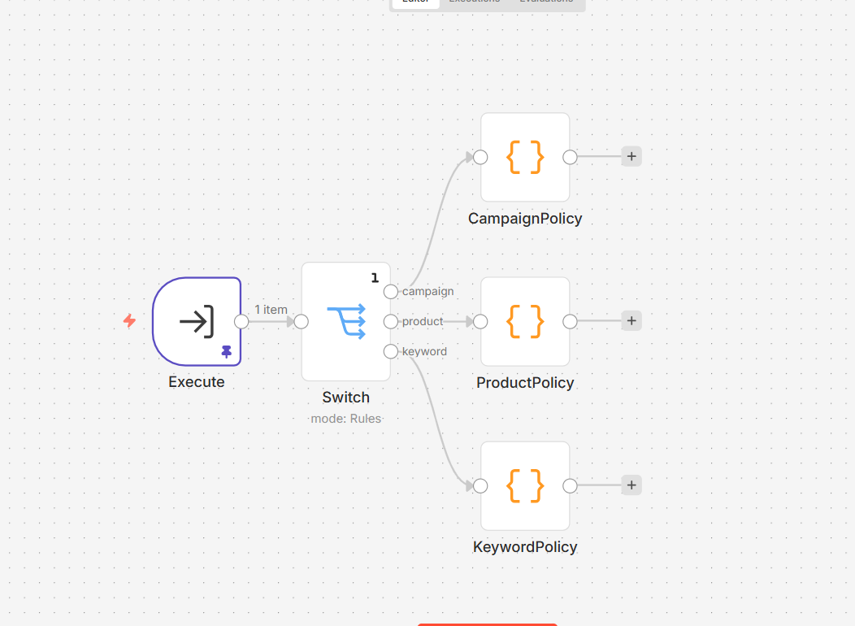
DecisionPolicyEngine
Defines what the AI agent is allowed to do
Enforces business rules and safety constraints
Input:
mode: campaign | product | keyword
Processing:
Selects allowed business actions
Applies guardrails (limits, approvals, restrictions)
Output:
policy:
business_actions (allowed operations)
guardrails (constraints & safety rules)

Slide 5
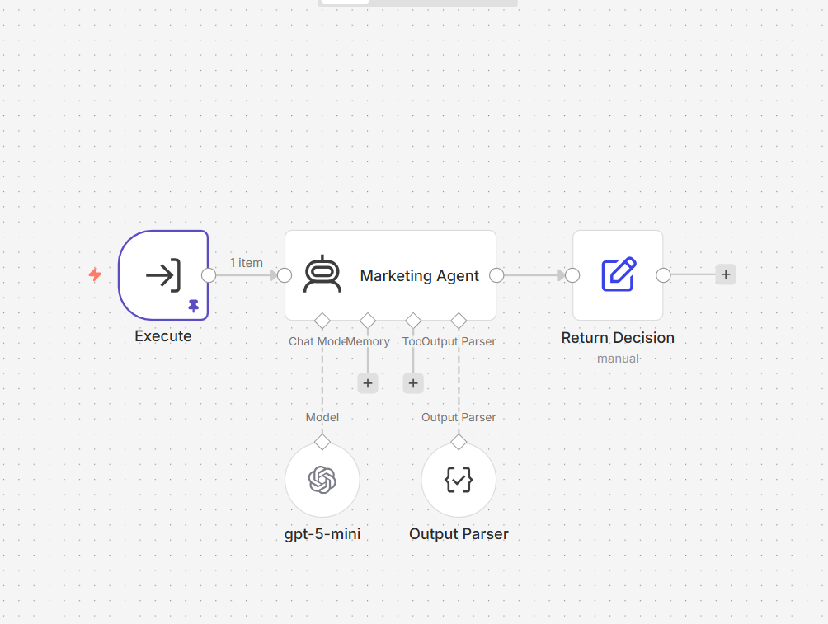
MarketingOptimizationAgent
Analyzes performance and generates optimization decisions
Transforms structured context into actionable recommendations
Input:
request (objective & constraints)
policy (allowed actions & guardrails)
entity (campaign / product / keyword)
summary (performance metrics)
Processing:
Interprets KPIs (ROAS, ACoS, CTR, CVR, CPC)
Identifies inefficiencies and opportunities
Selects actions ONLY from allowed policy
Applies guardrails (limits, approval requirements)
Output:
decision:
diagnosis (performance explanation)
recommended_actions (structured, constrained)
summary_for_user (business-friendly explanation)

Slide 6
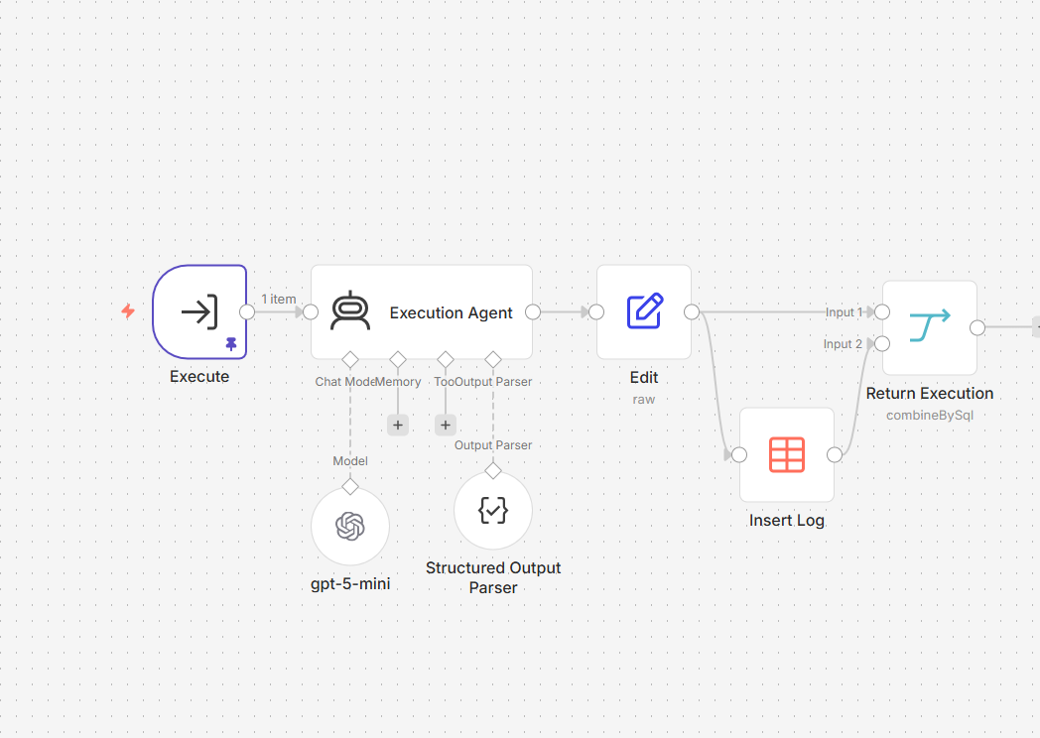
Execution Agent
Converts AI recommendations into controlled action records
Validates actions against policy and guardrails
Creates an audit trail for every recommendation
Input:
request | policy | entity | summary
decision from MarketingOptimizationAgent
Processing:
Checks if each action is allowed
Validates bid/budget change limits
Marks actions as pending human review
Rejects invalid actions if needed
Output:
execution:
logging:
valid action records
rejected actions
execution status
next step
Writes execution results into a separate log table
No live changes are executed in the MVP

Slide 7
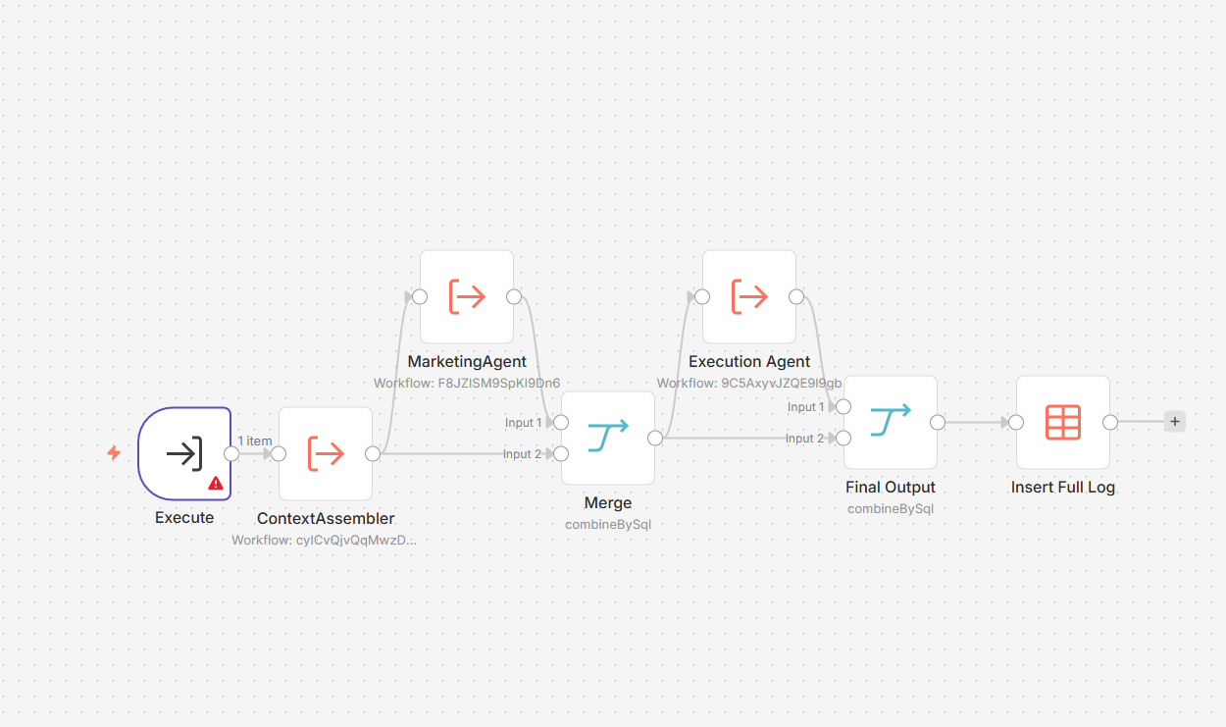
Main Orchestrator
End-to-End Execution Flow
Central workflow that orchestrates the entire AI system
Connects all modules into a single decision pipeline
Input:
User request (mode, filters, objective, automation level)
Flow:
ContextAssembler → builds decision context
MarketingOptimizationAgent → generates recommendations
Execution Agent → validates and structures actions
Insert Log → stores full execution trace
Output:
Full decision pipeline result:
logging:
context (request + policy + entity + summary)
decision (diagnosis + actions)
execution (validated actions + status)
Entire flow is stored in a centralized log
Enables traceability, debugging, and future automation

Slide 8


Future Improvements
Automation & Scaling
MVP Improvements (Next Steps):
Enable API-based execution:
bid & budget adjustments
keyword management (add / remove / pause)
Add historical data tracking & performance monitoring
Improve synthetic data generation (if real data is limited)
Move data processing to backend (API-based architecture)
Introduce PostgreSQL data layer:
Company
Campaign
AdGroup
Product
Keyword
Expand input capabilities (more flexible requests & filters)
Extend configuration system (policies, thresholds, rules)
Add Validator Agent for additional safety layer
Long-Term Vision
Feedback loop: learn from past actions and outcomes
Action prioritization (impact vs risk scoring)
Multi-agent system (media + creative optimization)

Slide 9
MVP to Scalable System
4 weeks plan
Week 1 — Backend Foundation:
Week 3 — Automation Layer:
Set up backend architecture (API-based)
Integrate PostgreSQL database
Define core entities:
Company, Campaign, AdGroup, Product, Keyword
Implement synthetic data generation (if needed)
Connect backend API with execution logic
Enable safe automation:
bid & budget adjustments
keyword management actions
Maintain human-in-the-loop control
Week 2 — System Expansion:
Week 4 — Testing & Deployment:
Extend modes:
campaign
product
keyword
combinations
Expand input flexibility (filters, objectives)
Improve configuration system (policies, thresholds)
Add unit & integration tests
Dockerize the system
Prepare GitHub repository + documentation
Final improvements & system validation

Slide 10

Additional Materials
GitHub:
https://github.com/ixor911/Amazon_ads_system
The repository contains:
System screenshots and workflow images
Synthetic data generation structure
Full n8n workflow structure
Technical README documentation

